Slide 1
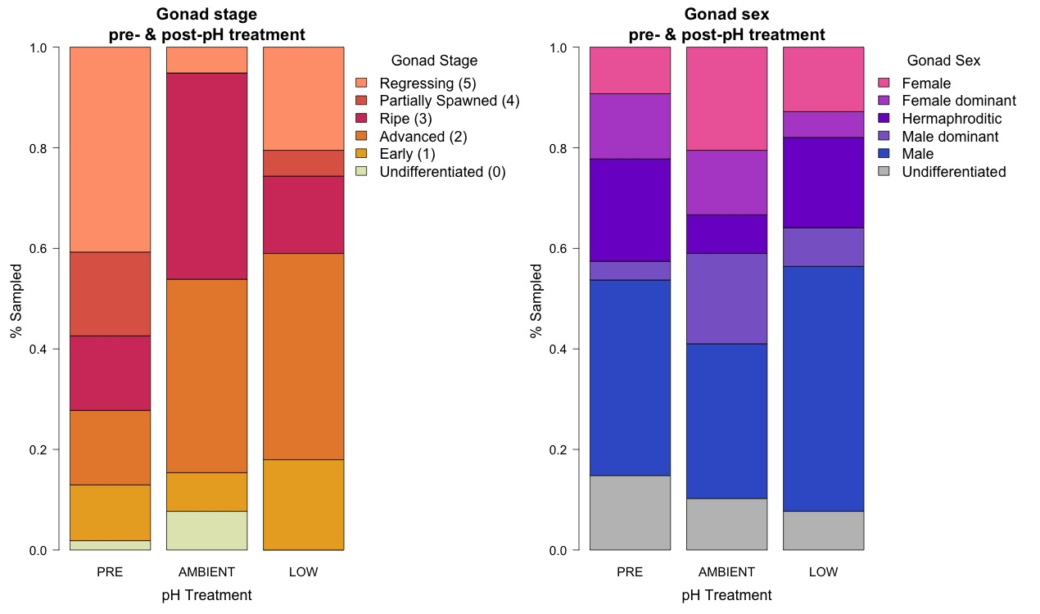
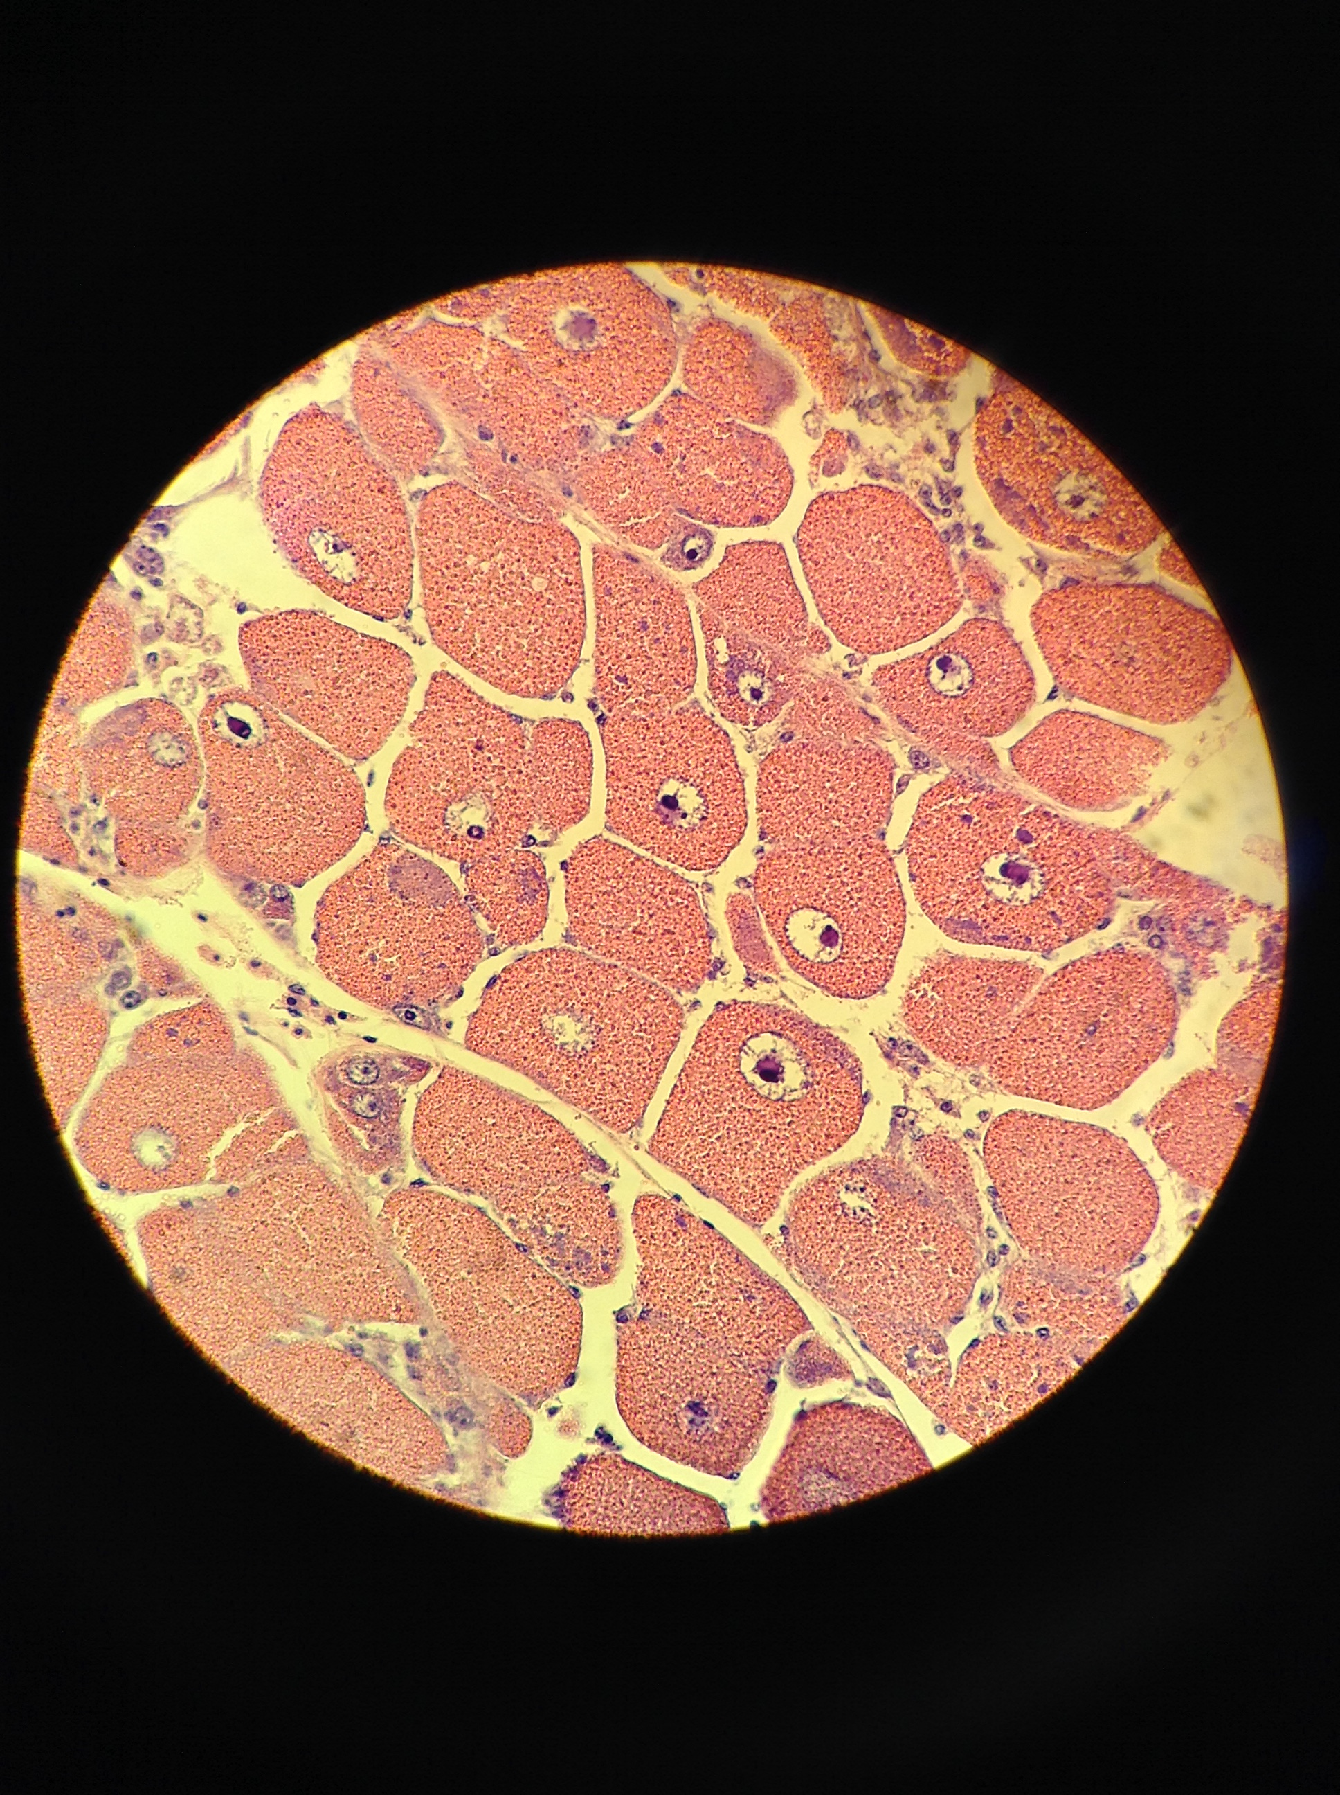
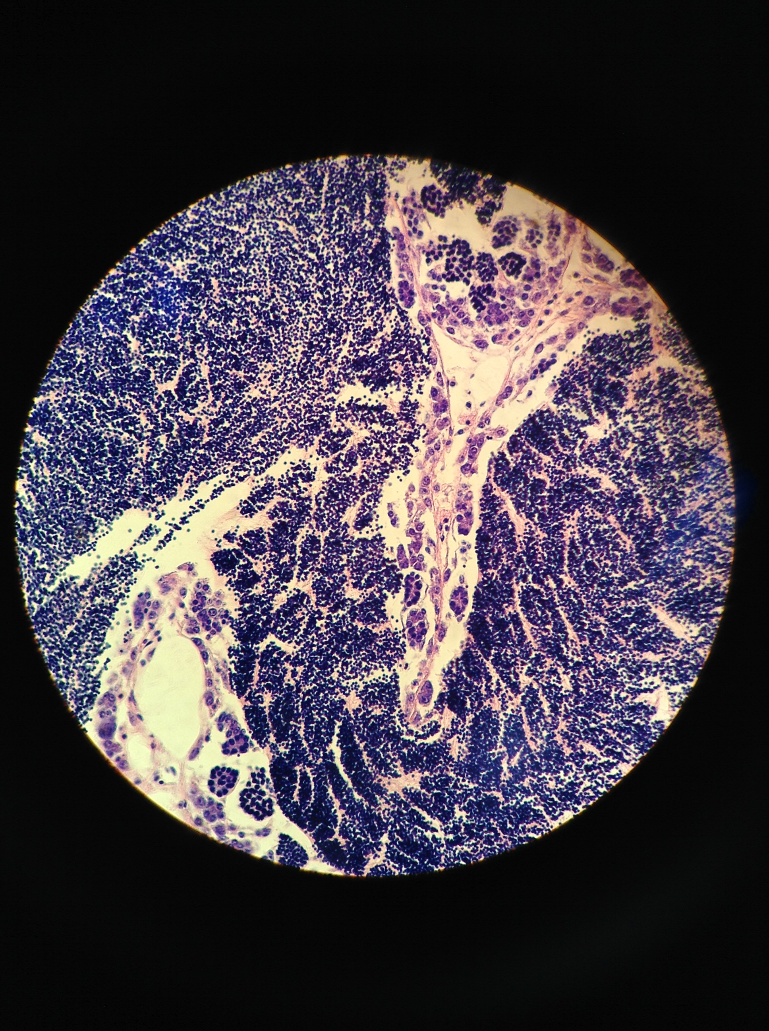
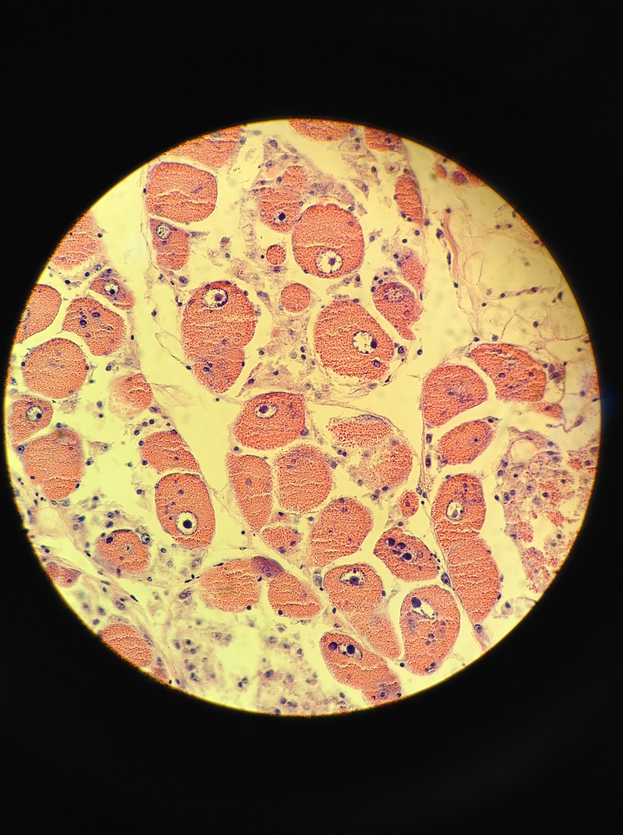
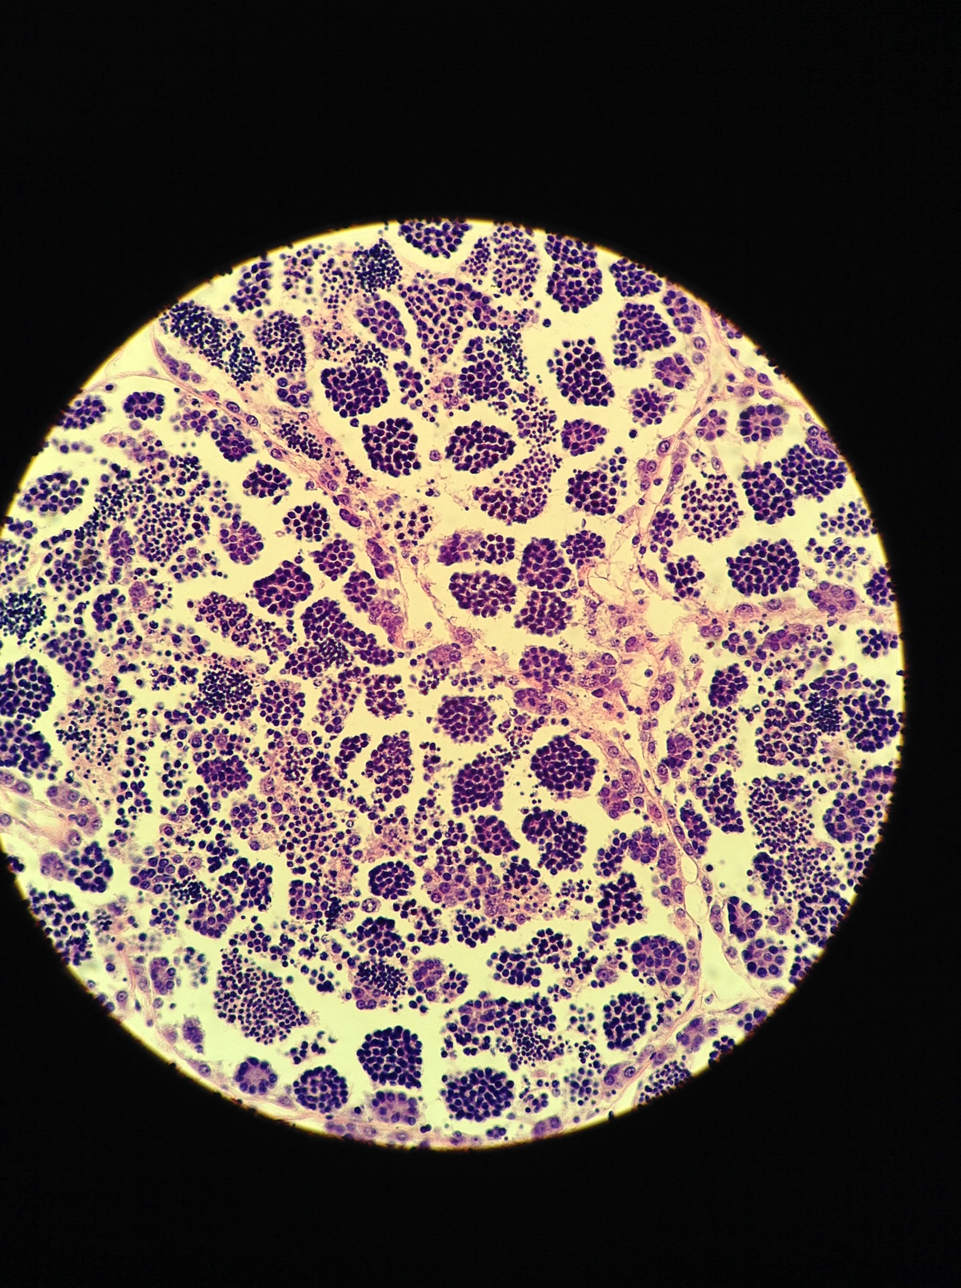
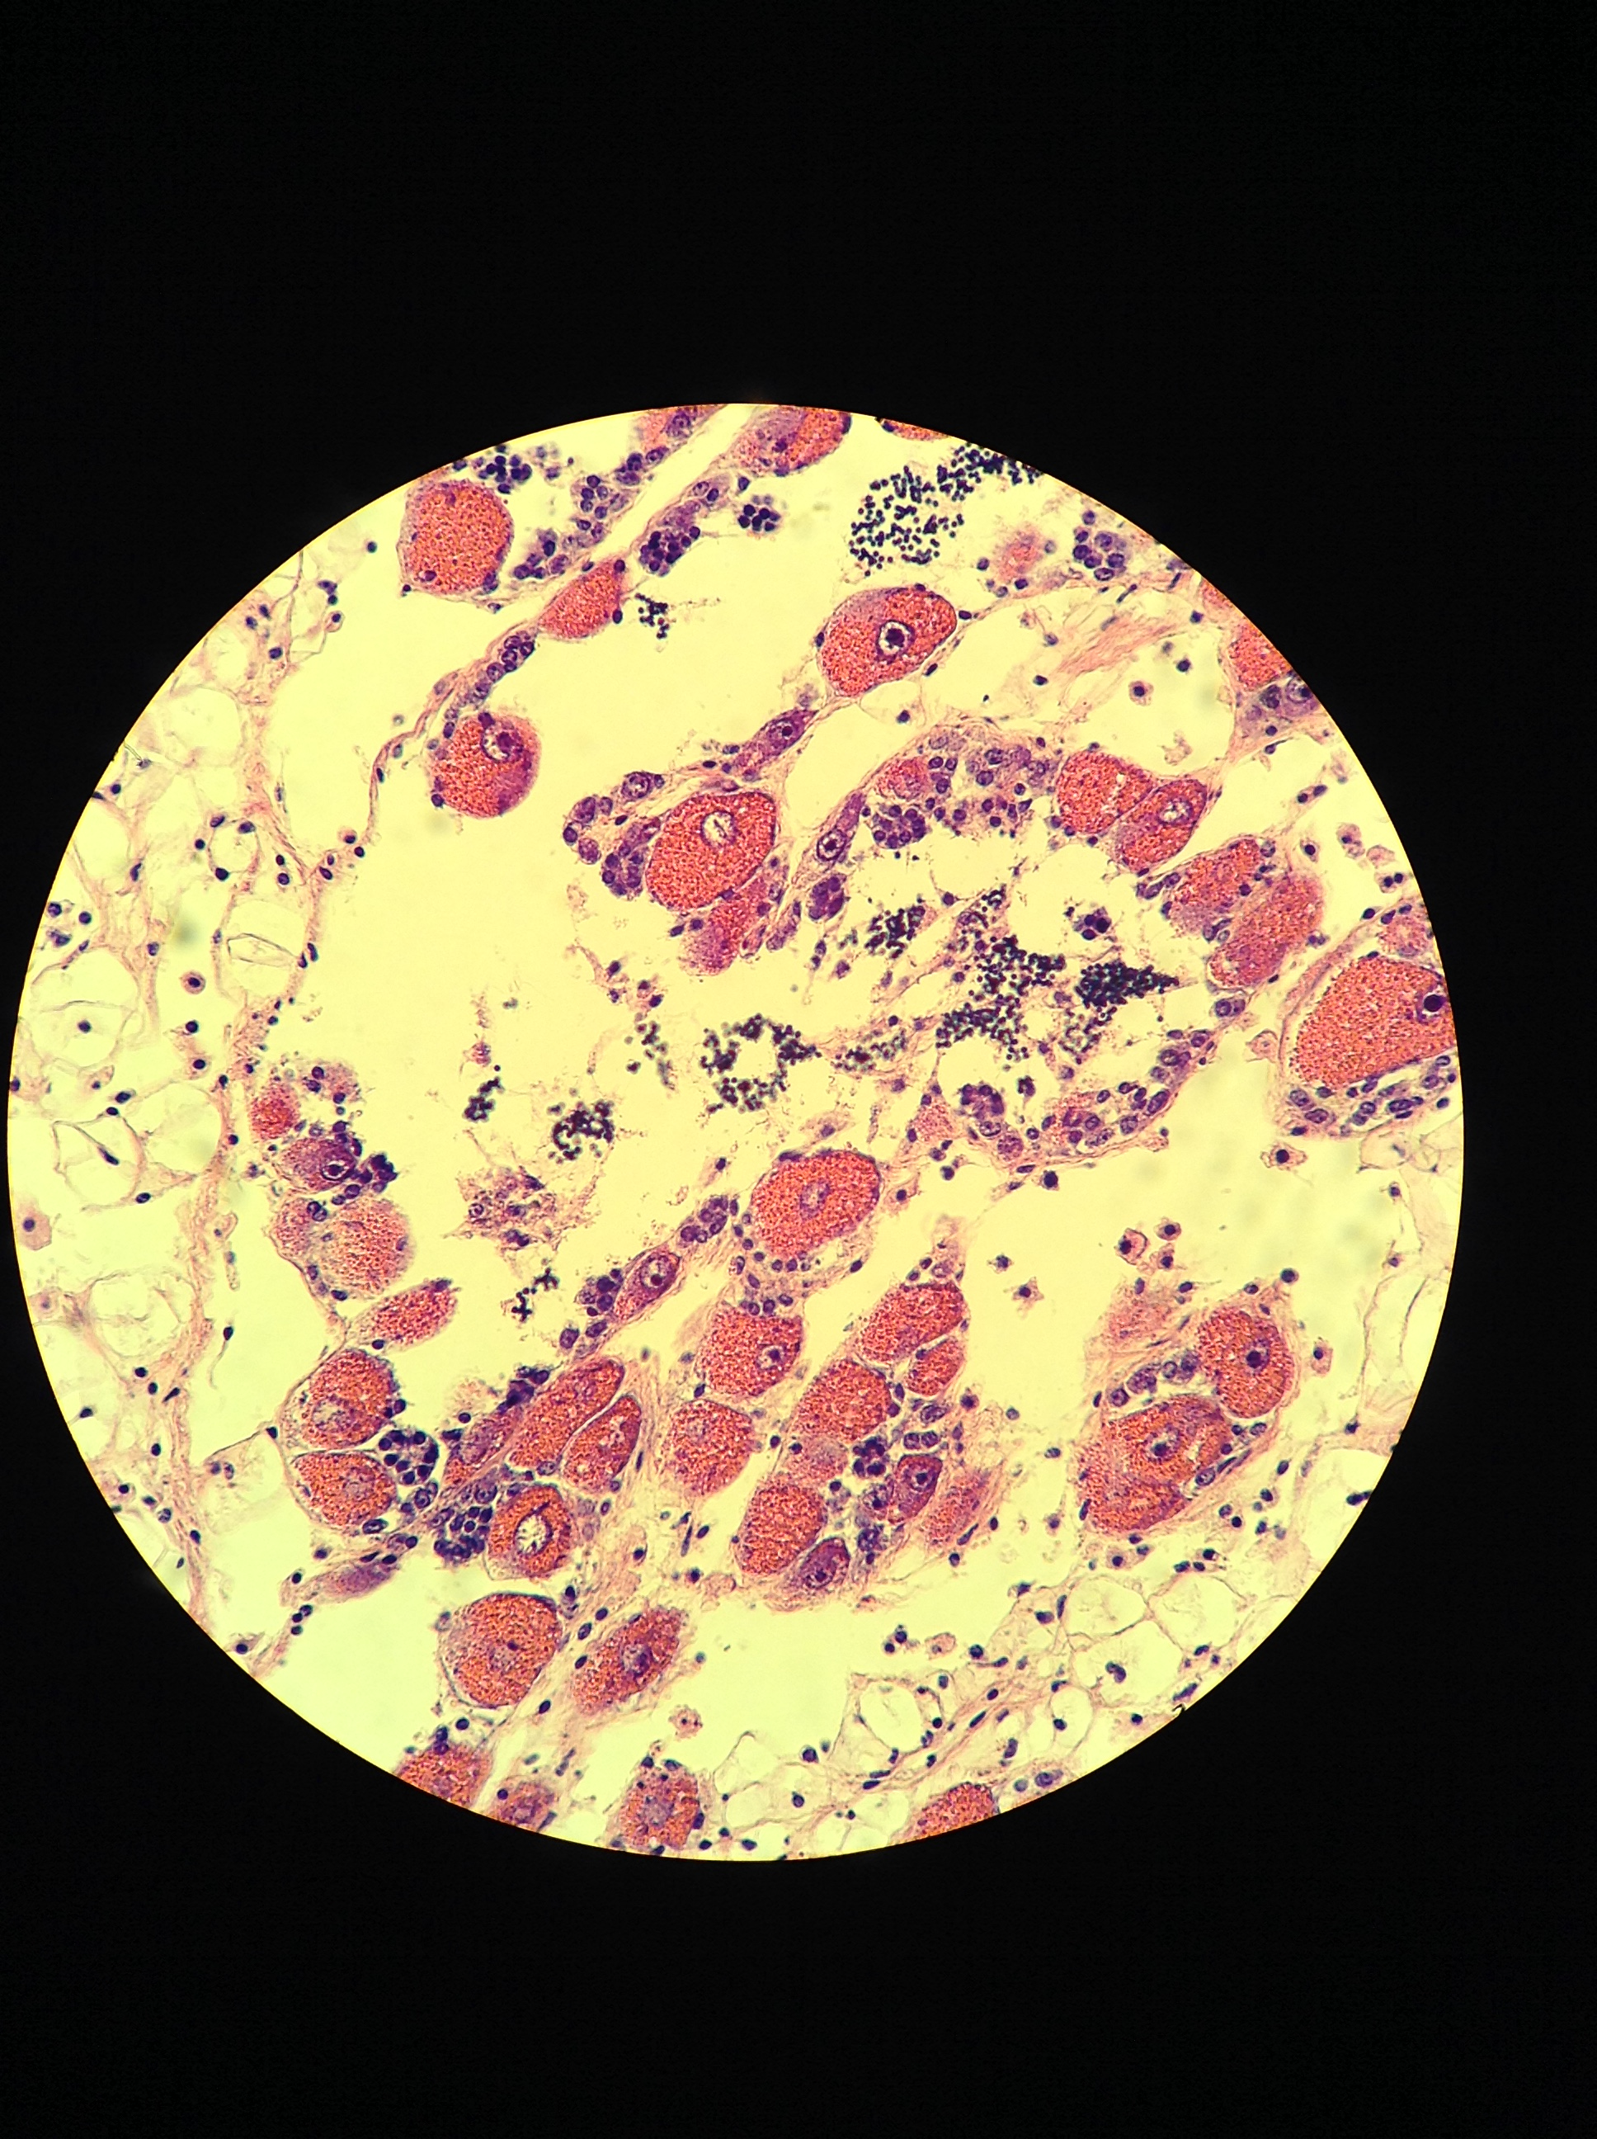
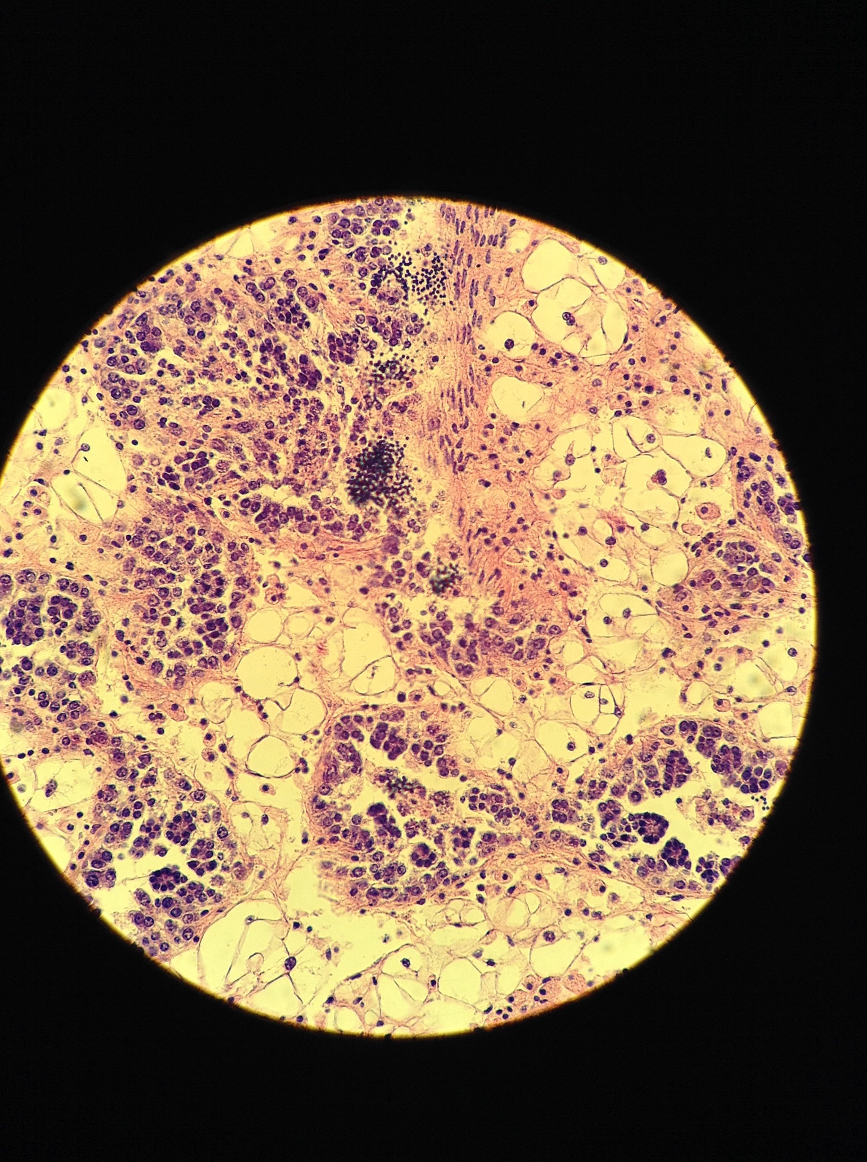
Female
Male
3
5
2
4
3
1
2
1
Notes:
Figure 6: Gonad stage and sex before pH treatment (n=54) and after 52 days in ambient pH (7.82±0.02, n=39) and low pH (7.31±0.02, n=39). Gonad developed during the 52 days in both treatments, but oysters in low pH had significantly less developed gonad compared to ambient pH (Fisher’s Exact Test, p=0.00829). Sex ratios did not differ significantly between treatments. Example stage 1, 2 and 3 gonad sections are shown for female-only and male-only oysters.

Slide 2
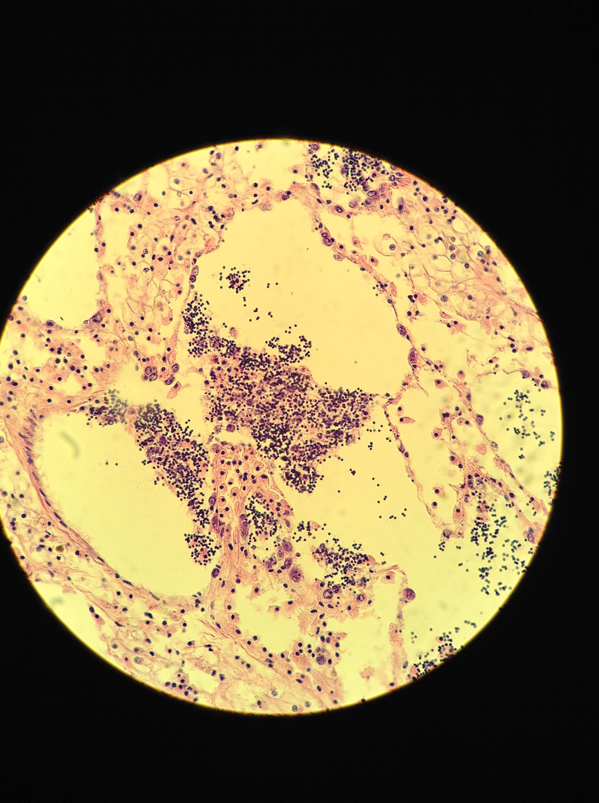
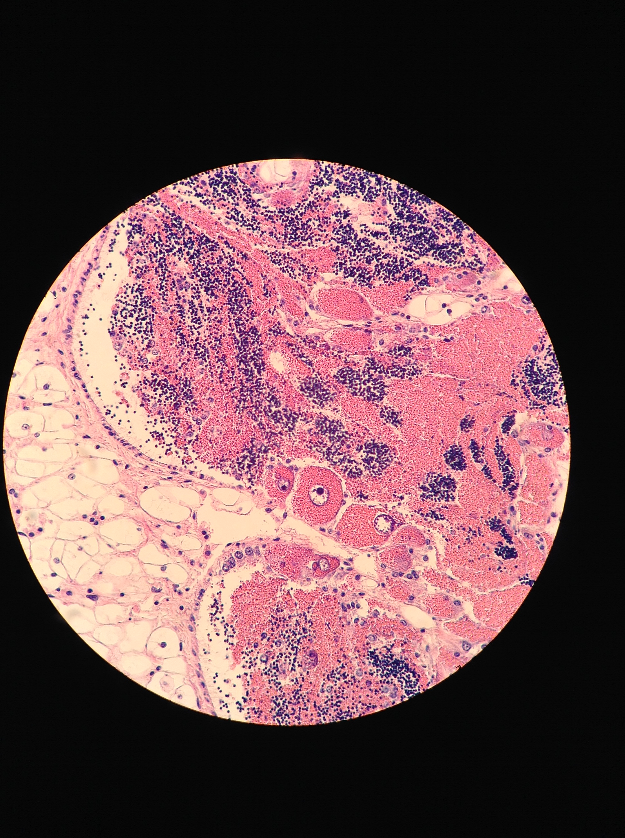
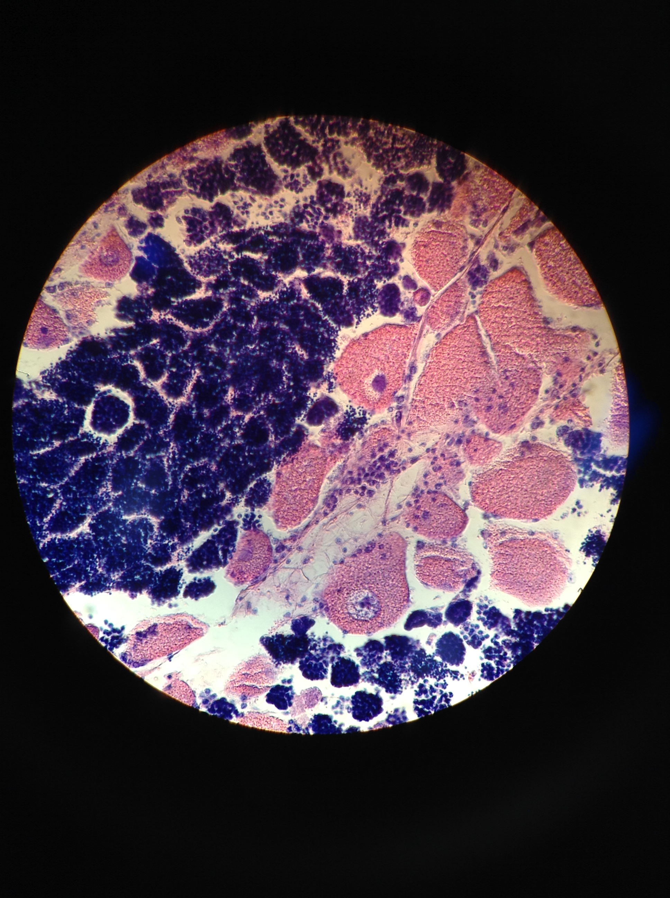
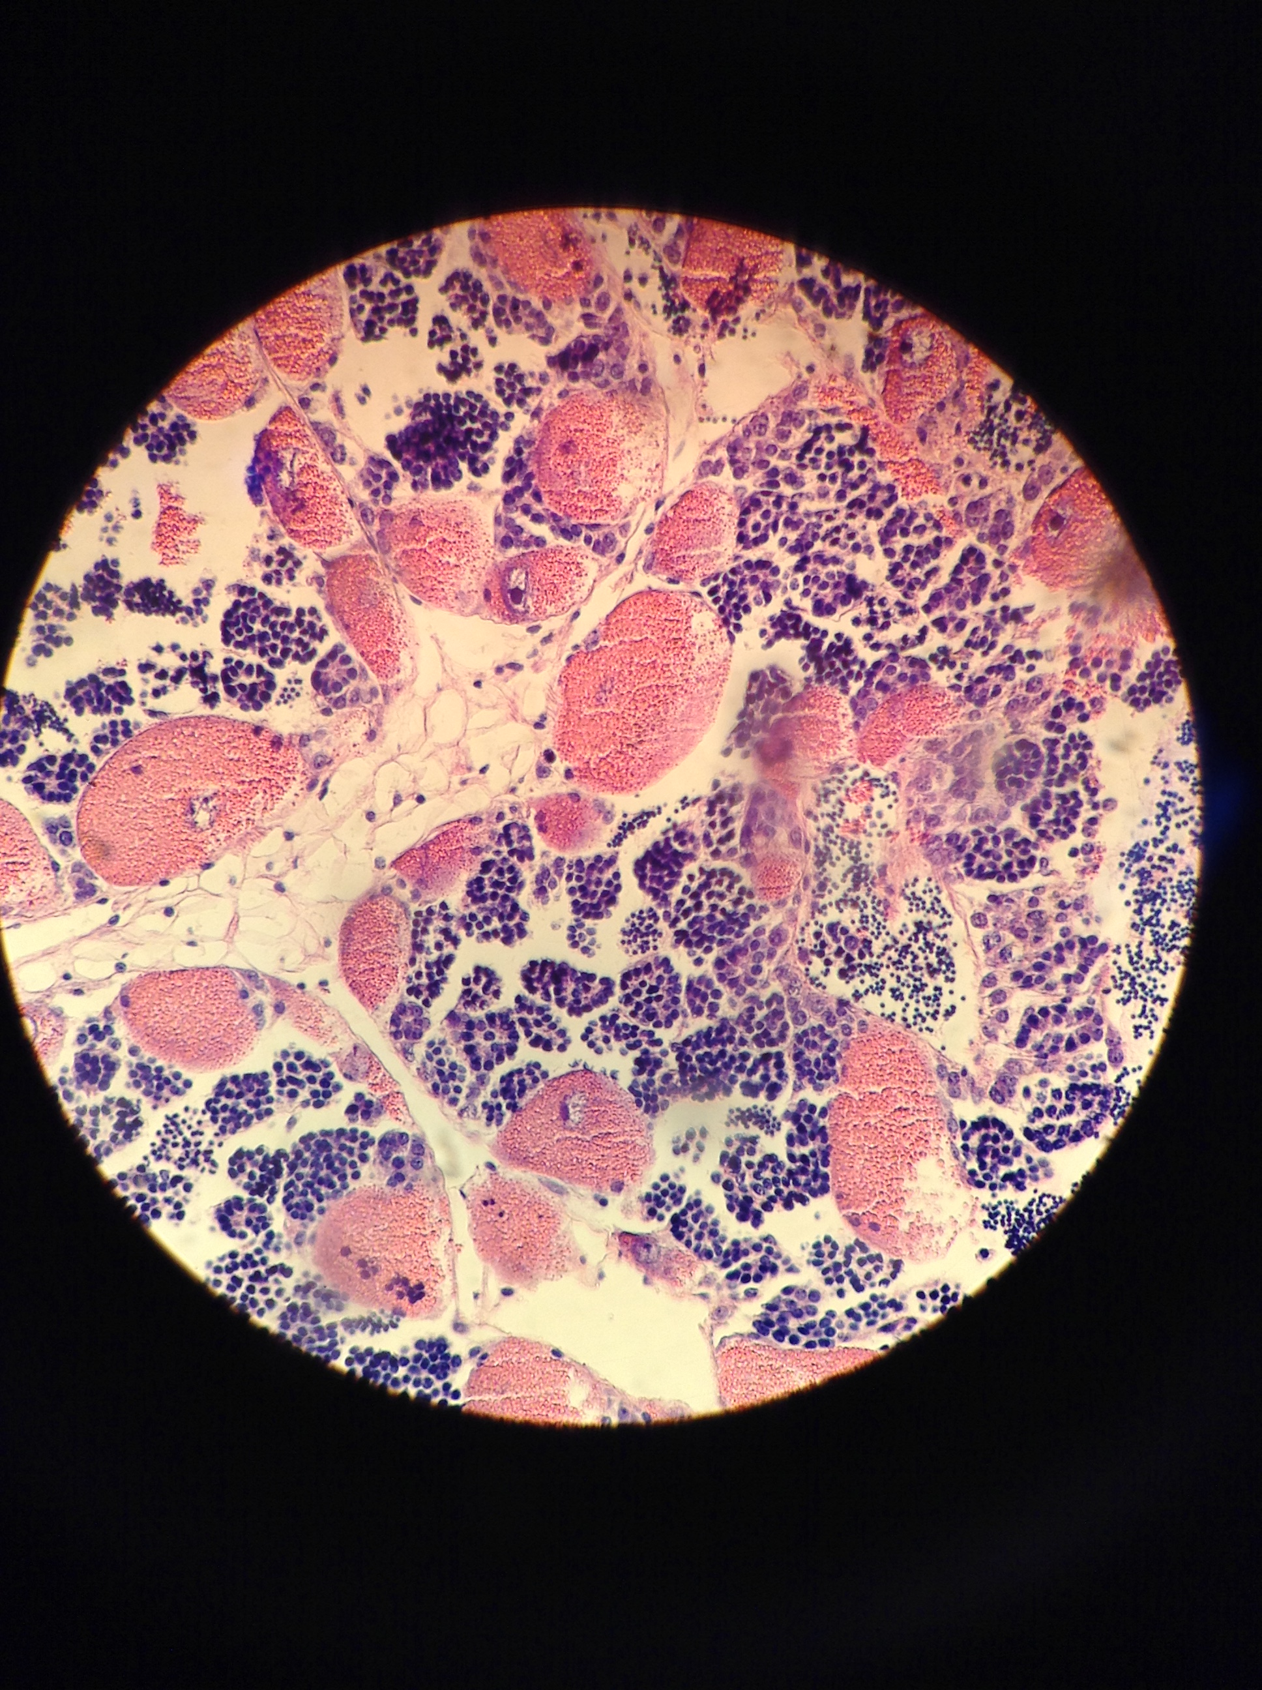
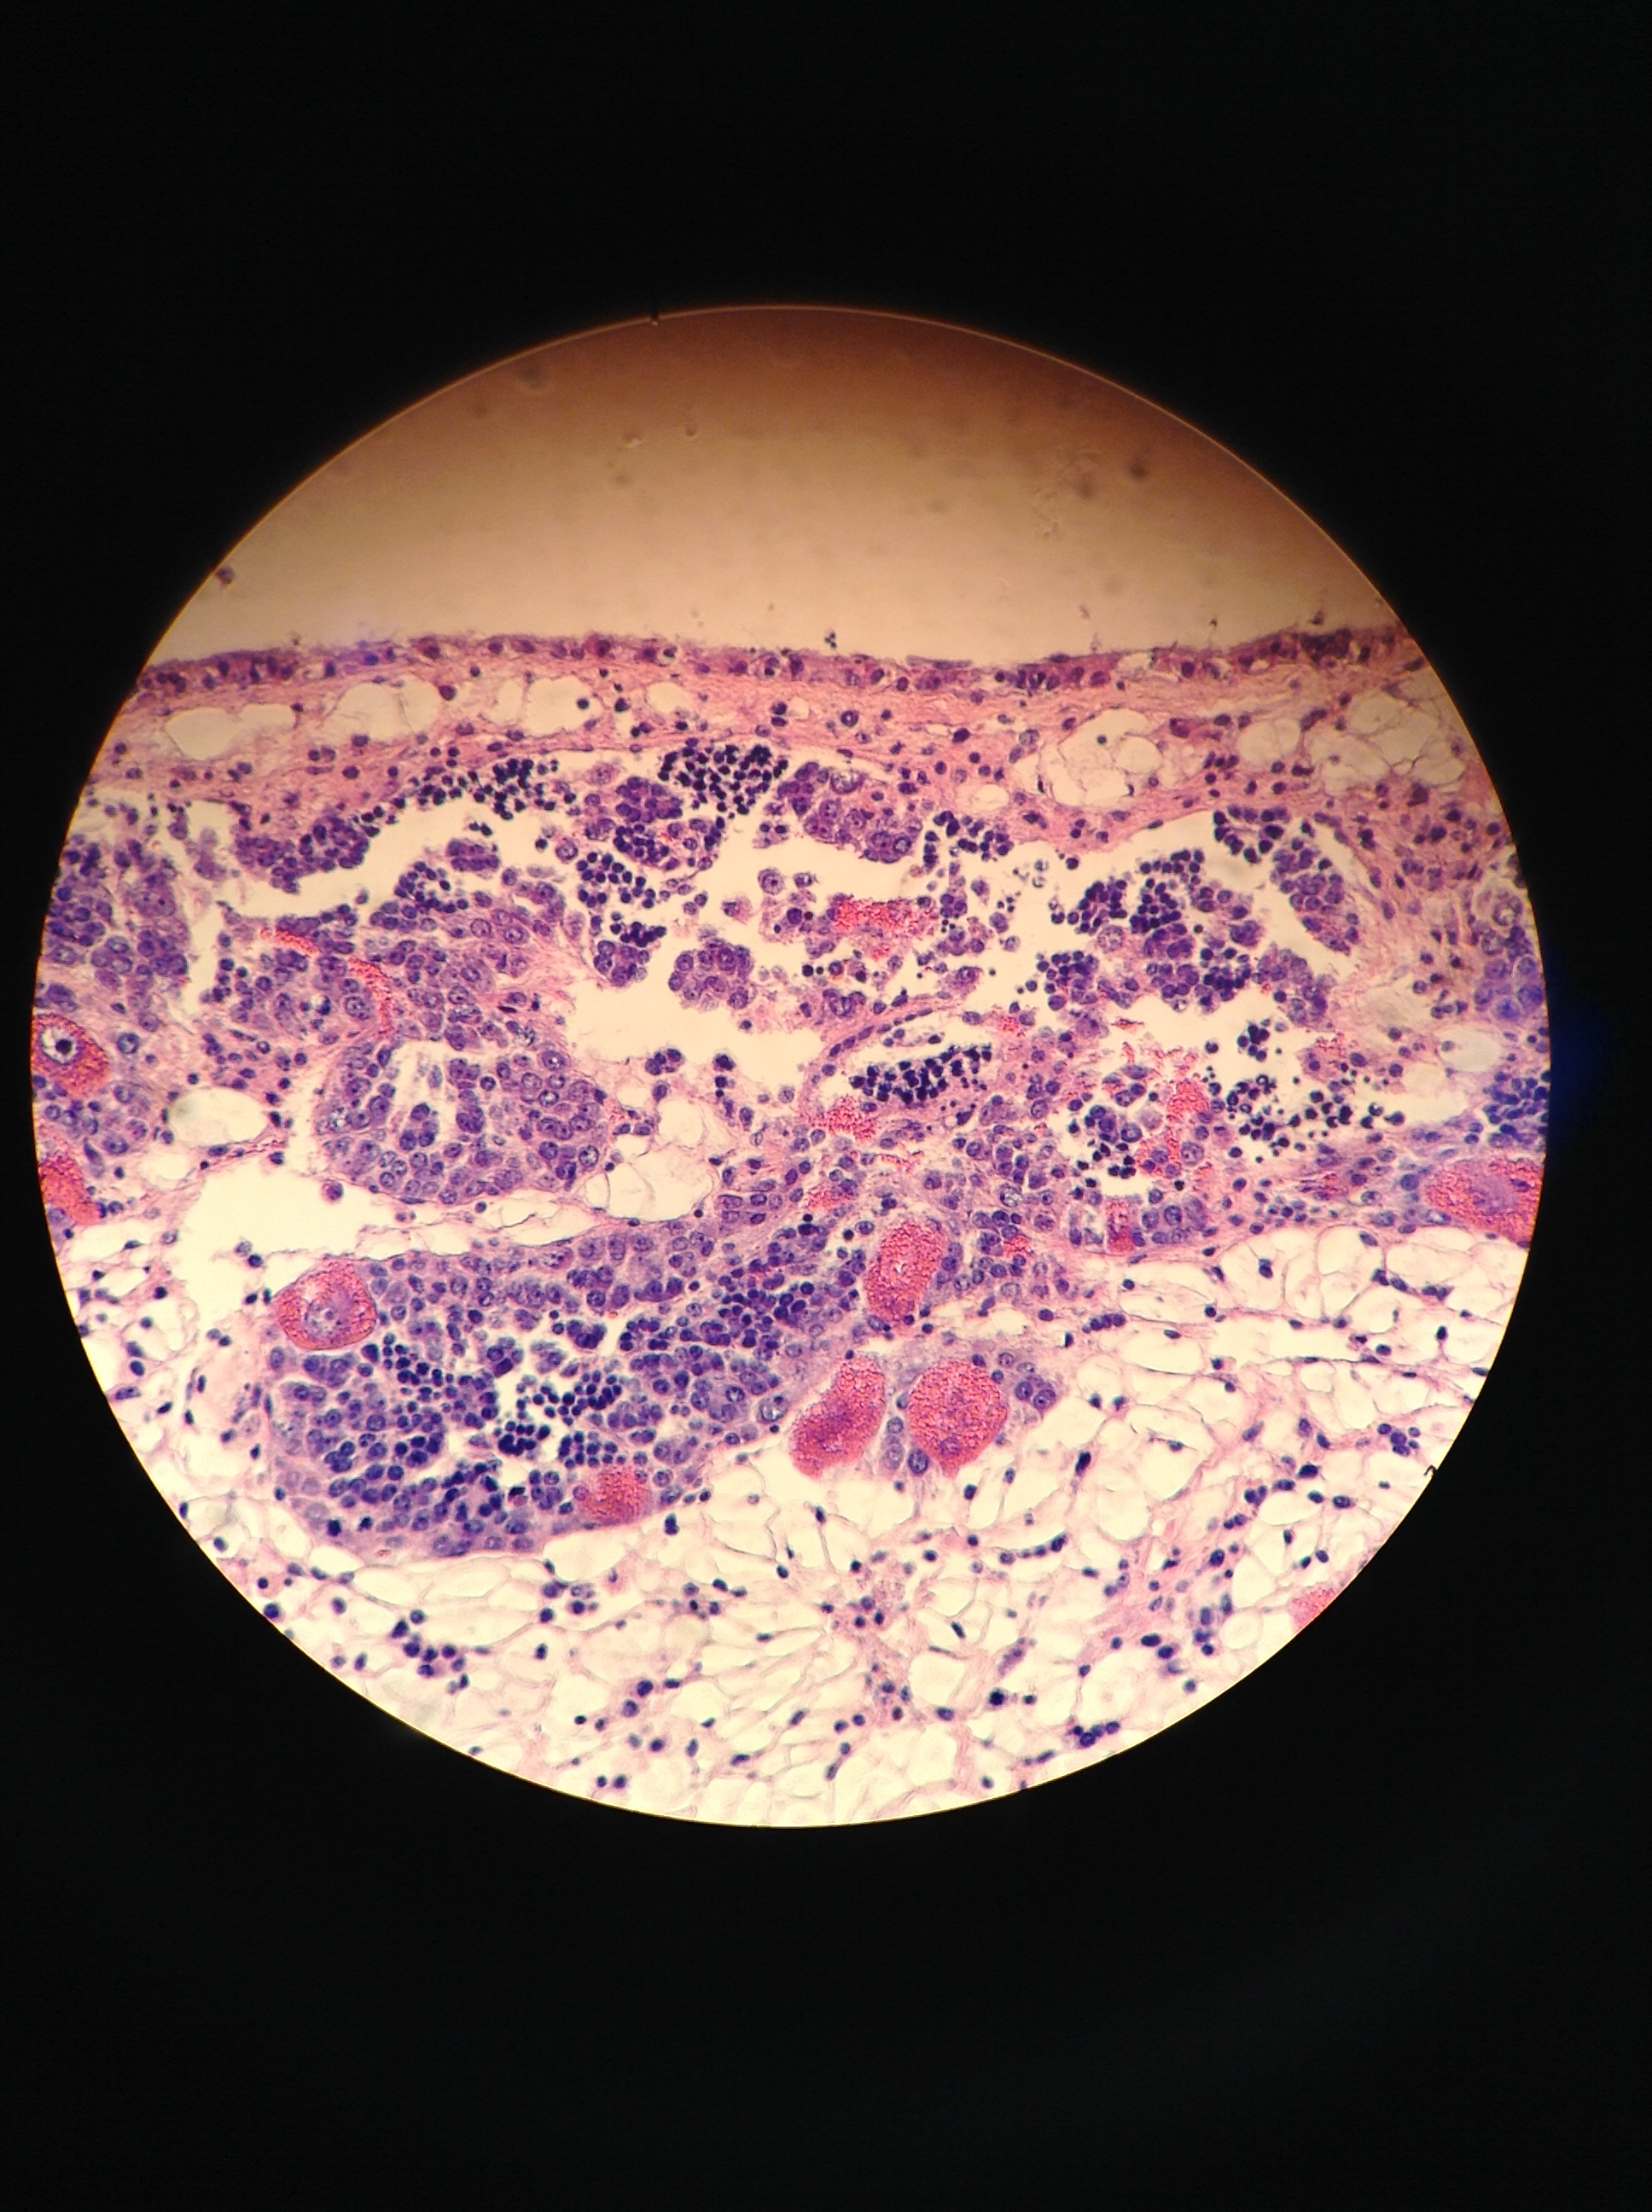
Female
Male
Hermaphroditic
4
None present
3
2
1
0

Slide 3
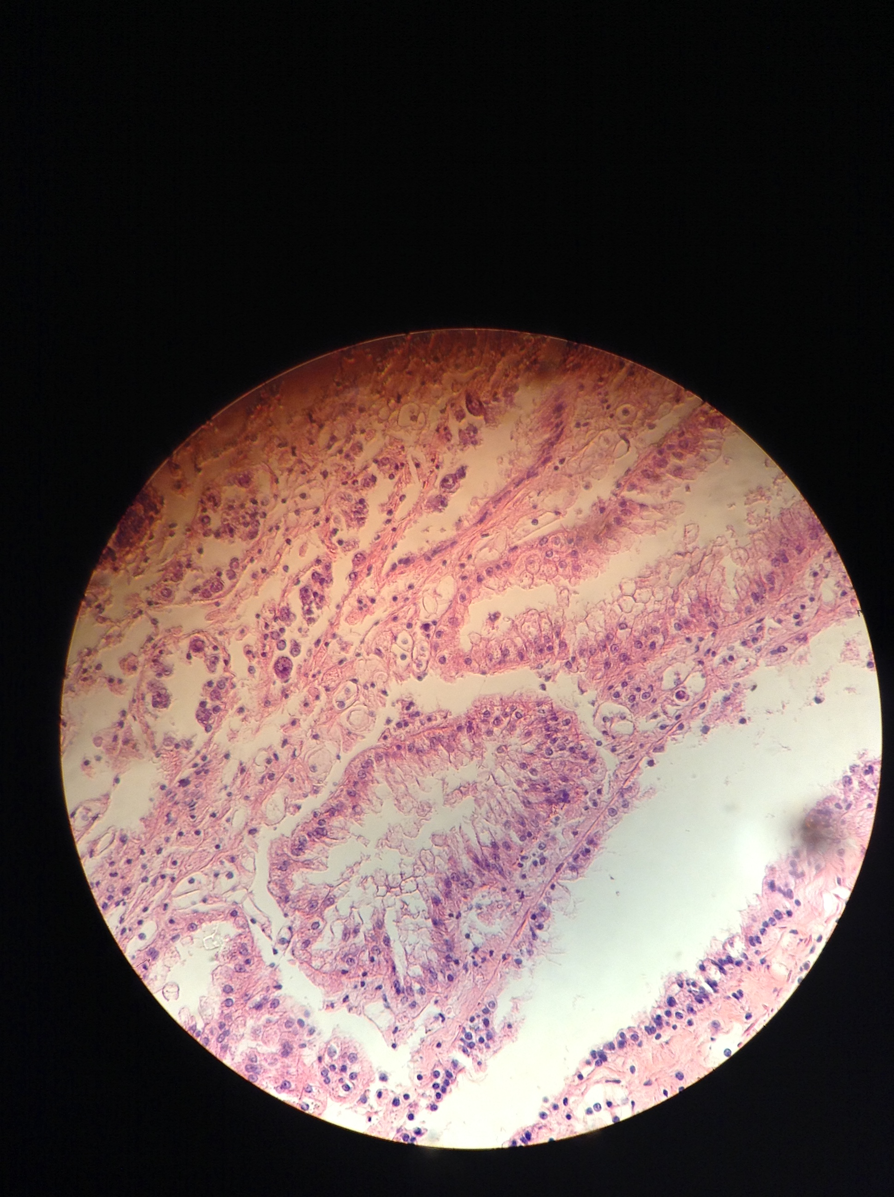
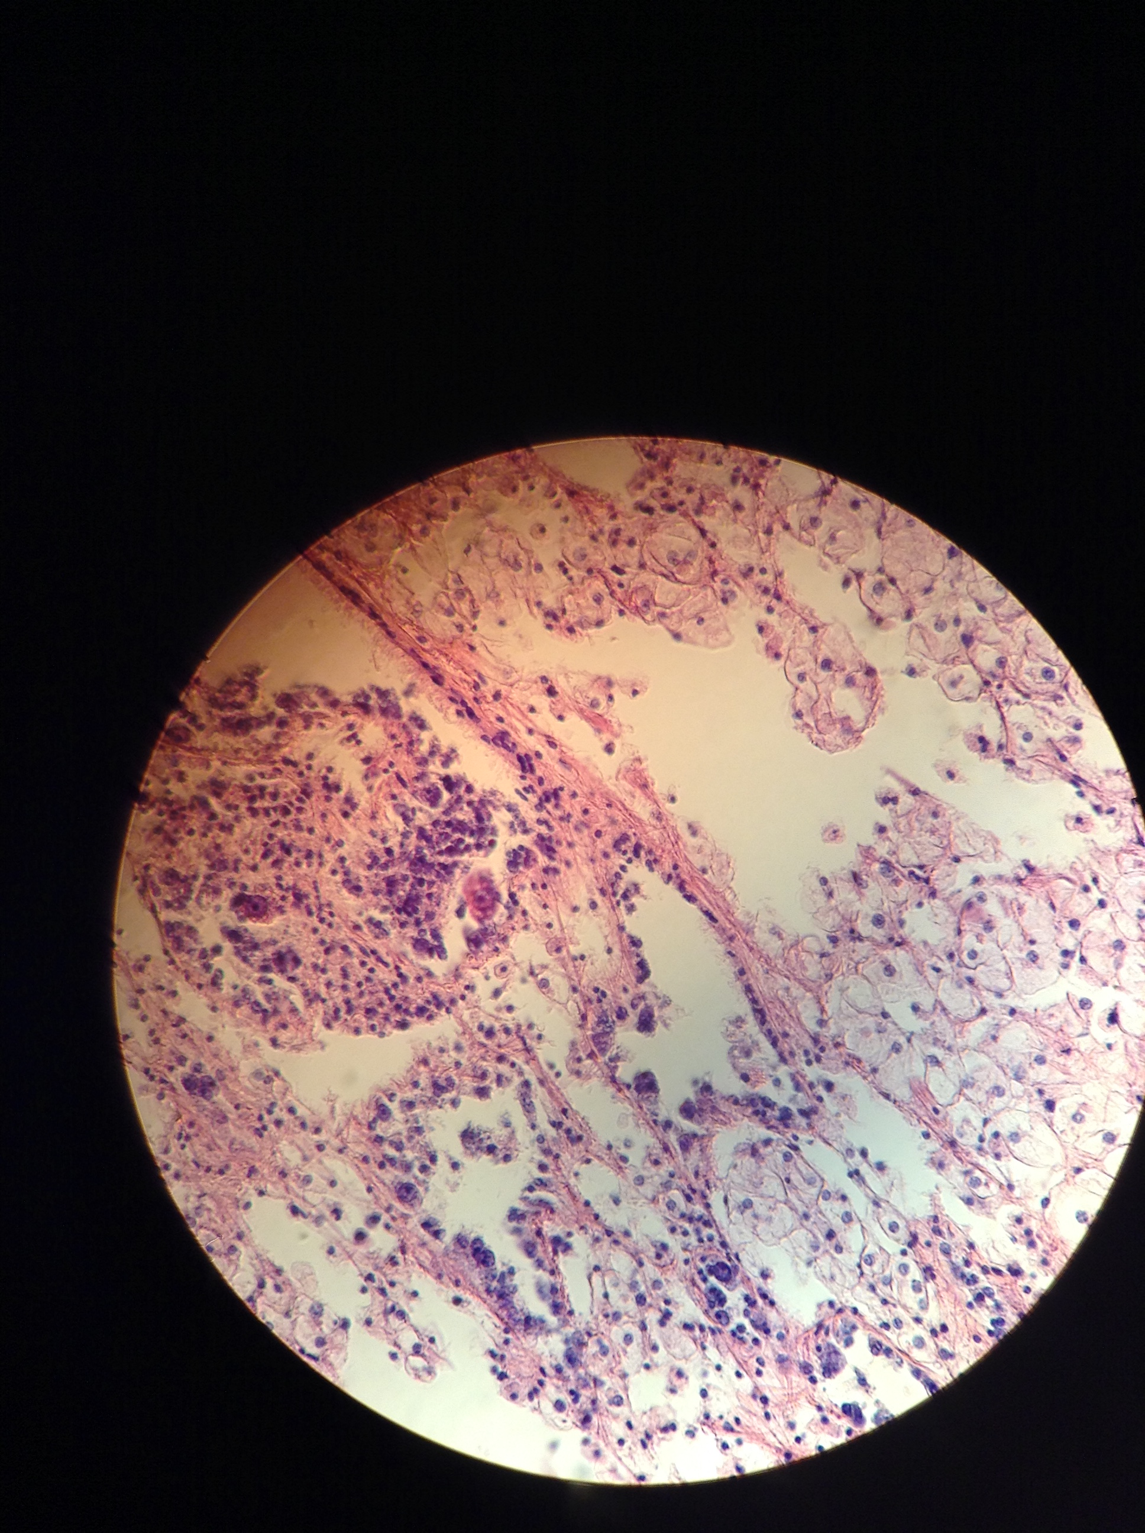
Female
Male
Hermaphroditic
4
None present
3
2
1
0
Notes:
Stage 4 male: NF6-#7
Stage 4 herm: NF6-#6
Stage 0: SN6-31

Slide 4
6°C pre-treatment
4
3
2
0
1

Slide 5
10°C pre-treatment
4
3
2
1
0
0

Slide 6
6°C Pre-Treatment
4
3
2
1
1
0

Slide 7
10°C Pre-Treatment
4
3
2
1
1
0

Slide 9
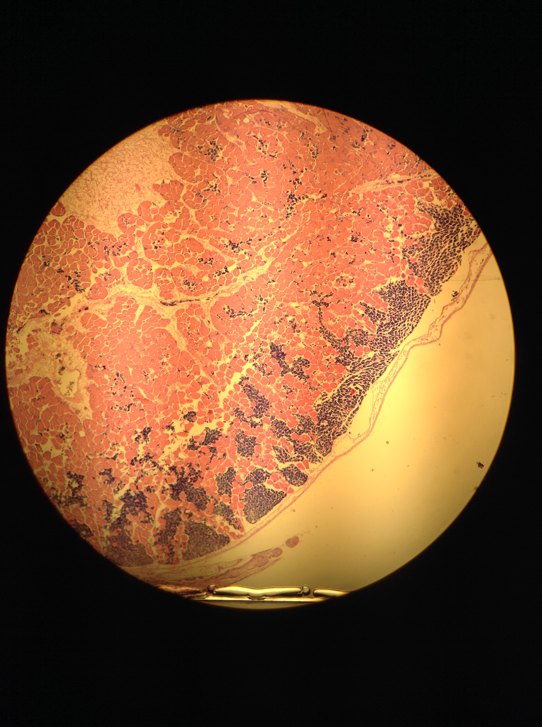
Good example of spatial hermaphroditism (my term)
Saw this often particularly with male gametes closer to surface

Slide 12
Dabob
Fidalgo
Oyster F2
Oyster F1
Dabob
Fidalgo
Oyster F1
Oyster F2

Slide 13
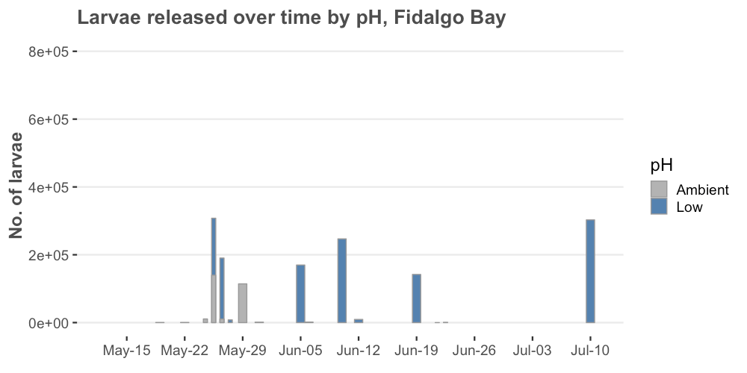
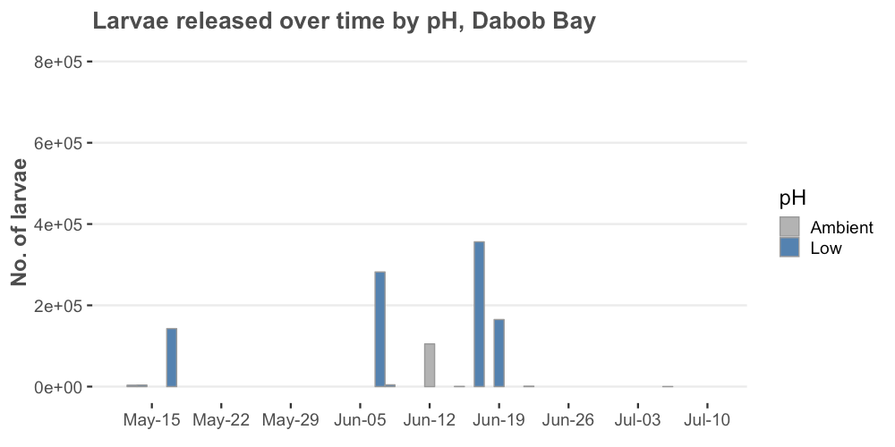
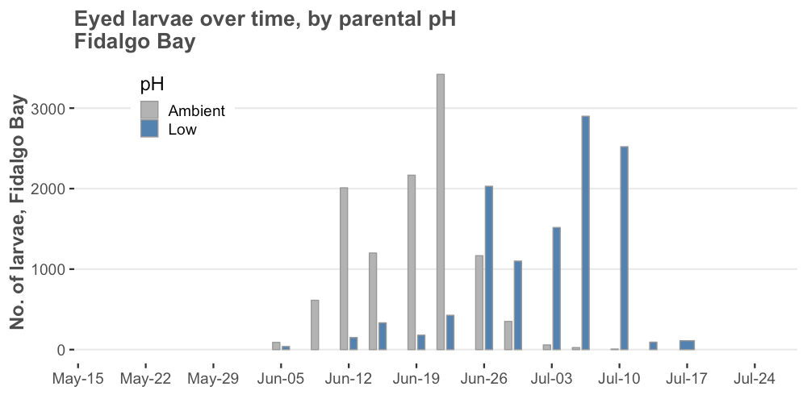
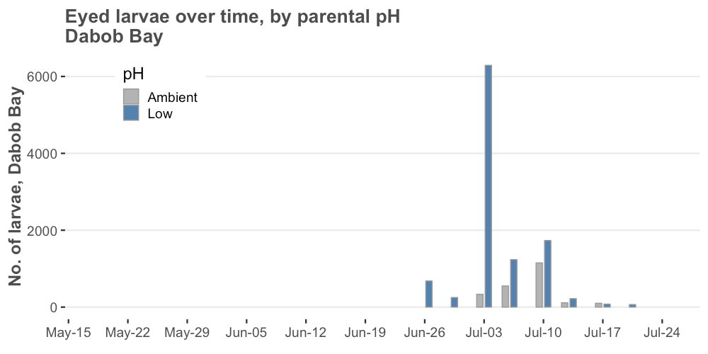

Slide 14
